Slide 1
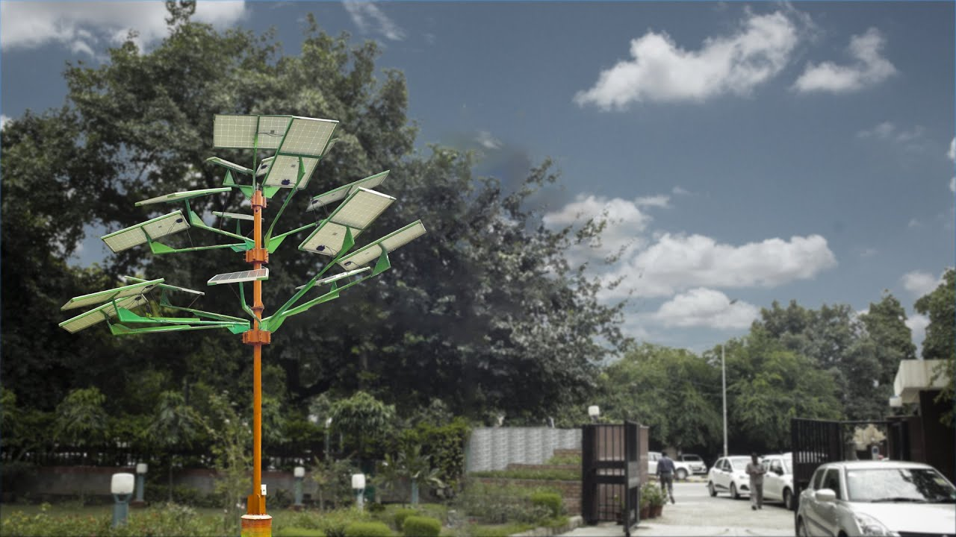
SOLAR TREE

Slide 2
CONTROL SYSTEM PROJECT
TOPIC : SOLAR TREE
Presented By:
RISHABH
IEC2018049
ANKIT SINGH
IEC2018076
MUAZIM BASHIR WANI
IEC2018085

Slide 3
CONTENT
1. INTRODUCTION
2. ADVANTAGES
3. DISADVANTAGES
4. APPLICATIONS
5. CONCLUSION

Slide 4
INTRODUCTION
NOW A DAYS WITH THE GROWING POPULATION AND ENERGY
DEMANDS WE SHUOLD TAKE A RENEWABLE OPTIONS OF
ENERGY SOURCES AND ALSO WE SHOULD KEEP IN MIND THAT
ENERGY SHOULD NOT CAUSE POPULATION AND
OTHER NATURAL HAZARDS .
IN THIS CASE SOLAR ENERGY IS BEST OPTION
HERE TREE STANDS FOR
T-TREE GENERATING
R-RENEWABLE
E-ENERGY AND
E-ELECTRICITY

Slide 5
ADAVANTAGES
1. REDUCES AIR,GROUND AND WATER POLLUTION
2.DECREASED RATES OF NON RENEWABLE ENERGY
3.WE WOULDN’T BE WORRY ABOUT THE FUTURE ENERGY RESOURCES
4. DECREASE IN THE USAGE OF NATURAL RESOURCES
5. LESS LAND REQUIREMENT (0.10 TO 0.15 ACRES )

Slide 6
DISADVANTAGES
1. MAY CAUSE HAZARD TO BIRDS AND INSECTS
2. COSTLY
3. HAZARD TO EYESIGHT FROM SOLAR REFLECTOR

Slide 7
APPLICATION
1. STREET LIGHT
2. INDUSTRIAL POWER SUPPLY
3. CHARGING SLOT IN VEHICLES
4. HOUSE SUPPLY

Slide 8
CONCLUSION
1. TO FULFILL INCREASING DEMAND OF PEOPLE
2. SAVING OF LAND ,THIS PROJECT IS VERY SUCCESFUL ONE
3. THE EXTRA ENERGY CAN BE PROVIDE TO THE GRID
4. IT CAN PRODUCE ELECTRICITY EFFICIENTLY WITH OUT
ANY POWER CUT PROBLEM

